Slide 1
Making a Way
Metaphor and language to provide a way for engagement in ACT therapy for the Christian client
Grant Dewar M Ed, M Psych(Health ) PhD / M Psych (Clin ) Candidate

Slide 2
Building bridges –Breaking down walls
Thanks for your attention and interest
I am interested in building bridges for those who need the freedom afforded by psychological flexibility.
Not an attempt to evangelise or to enter into a debate about the worth of theism or atheism.
It is an attempt to meet the needs of a substantial sector of the community who will benefit from the approaches offered in ACT to improve the quality of their life

Slide 3
Recent Debate Christianity and Psychology
ACT provides an open door to all to take effective action to enrich their lives.
Recent literature regarding the accessibility of psychology to those with a Christian faith.
Worthington (2010), Johnson et al (2010) and Tan (2011) to open pathways for engagement by individual Christians, Christian leaders, counselors and psychologists in discussing the use of evidence based psychological interventions by Christians.

Slide 4
Building bridges Breaking down walls
interest prompted by discussions with psychologists with a faith based or informed approach
a poster presented at the ACBS world conference in Sydney by Dudek-Glabicka,J., Malicki,S., Ostaszewski P (2013) Searching for Effective Strategies of ACT Dissemination in Poland (joannaedudek@gmail.com)

Slide 5
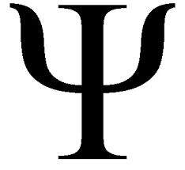
Christian engagement in ACT therapy

Slide 6
Aims for this Paper
Discuss the use of metaphor and language
Provide a way for engagement in ACT therapy by Christians and those who are engaged in providing therapy to Christians.

Slide 7
Aims for this Paper
The presentation will discuss the six elements of ACT
Richness of Christian metaphorical representations available to teach psychological skills :
Accept that which is out of our control,
Get unstuck,
Be willing to take perspective,
get in touch with the here and now,
confirm valued approaches to life and
Take effective action

Slide 8
Our Language
Please close your eyes

Slide 9
Our Language
My heart's desire | As white as snow
A drop in the bucket | As you sow so shall you reap
A fly in the ointment | Ashes to ashes dust to dust
A labour of love | At his wits end
A old as the Hills | The powers that be
A man after his own heart | The root of the matter
A peace offering | The salt of the earth
A thorn in the flesh | The skin of your teeth
A wolf in sheep's clothing | The spirit is willing but the flesh is weak
All things must pass | The strait and narrow
All things to all men | The sweat of your brow

Slide 10
Parables - Metaphors
"He began to teach them many things in parables." (Mark 4:2)
Gospel parables are images, stories and actions as illustrations.
Word pictures provided vivid examples for guidance and understanding.
Metaphors for all backgrounds to develop their understanding of a new pathways to understanding and freedom.

Slide 11
Parables - Metaphors
Commonly understood and experienced events
costly lost pearl,
buried treasure waiting to be discovered,
sowing and seed,
a poor woman looking for her lost coin,
uninvited wedding guests.

Slide 12
Parables - Metaphors
Parables use common and everyday experiences which provide:
accessible comparisons
timeless insights into the human condition
layers of understanding - illustrating the unknown with the known

Slide 13
Suffering
Suffering or Dukkha is commonly explained according to three different categories:
The obvious physical and mental suffering associated with birth, growing old, illness and dying.
The anxiety or stress of trying to hold onto things that are constantly changing.
A basic unsatisfactoriness pervading all forms of existence, because all forms of life are changing, impermanent and without any inner core or substance.
Wikipedia : http://en.wikipedia.org/wiki/Dukkha

Slide 14
Missing the Mark

Slide 15
The basis of suffering
The Idealised Self
Experiential Avoidance
Living absent of values
Cognitive Fusion
Unworkable thinking
Unworkable Action
Living elsewhere than here and now

Slide 16
Sin = Missing the Mark
hamartanó: to miss the mark, do wrong, sin
Original Word: ἁμαρτάνω Part of Speech: Verb Transliteration: hamartanó Phonetic Spelling: (ham-ar-tan'-o)

Slide 17
Sin = Missing the Mark
Short Definition: I sin Original Definition: I miss the mark
(a) I make a mistake,
(b) Commit a sin - missing the mark in behaviour regarding God or a fellow-creature
Strong's Concordance http://biblehub.com/greek/264.htm

Slide 18
Sin = Missing the Mark
Hamartía, Hamartánō is regularly used in ancient times of an archer missing the target
Every decision or behavior acted done apart from faith (pístis) is missing the target
Strong's Concordance http://biblehub.com/greek/264.htm

Slide 19
Sin = Missing the Mark
hamartánō ("not" and méros, "a part, share")
having no share in
to miss the mark brings forfeiture or loss
Strong's Concordance http://biblehub.com/greek/264.htm

Slide 20
Faith
faith is the evidence or conviction of things not seen
ACT – doing what works in spite of “facts” thoughts, feelings, physical sensation,

Slide 21
THE PRINCIPLES OF ACT
The Self as Observer
Acceptance / Willingness
Valued Living
Defusion /
Watch your thinking
Committed Action
Being Present
Living in the here and now

Slide 22
VALUES
The Beatitudes
Spiritual awareness
Meekness
Mercy
Purity of heart
Peacemaking
Willingness to sacrifice for the common good

Slide 23
The observant self
Before Abraham was I AM
An invitation to the eternal and transcendent
and
Bringing this perspective to the present

Slide 24
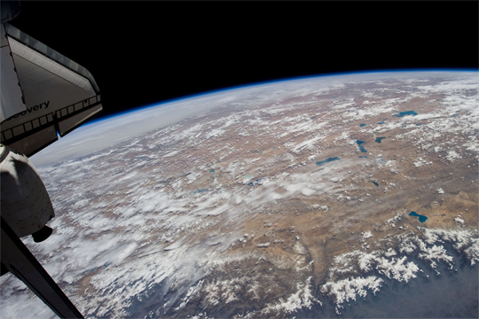
I AM

Slide 25
I AM

Slide 26
I AM

Slide 27
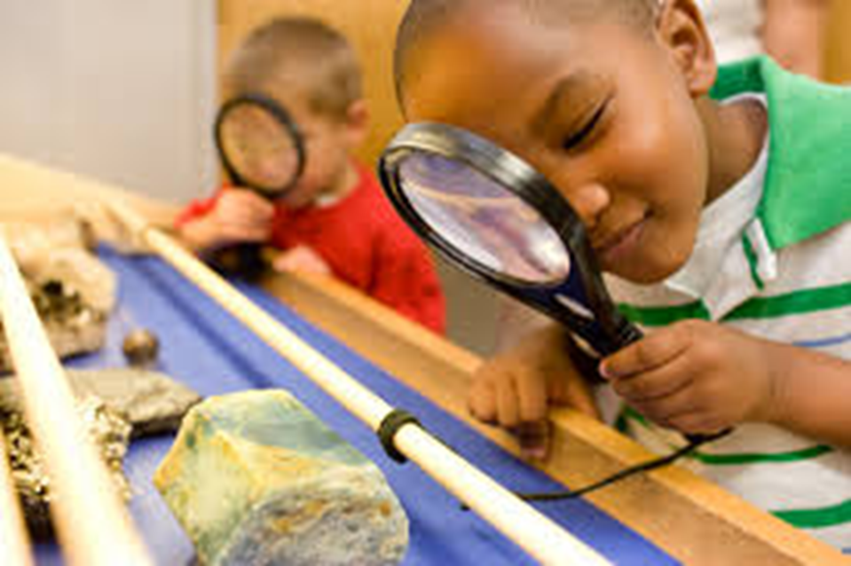
Who is the greatest?

Slide 28
Leaders who serve

Slide 29
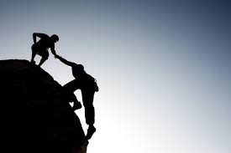
Rejection/destruction vs. the way

Slide 30
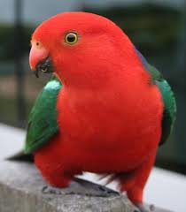
Focus on the Here and Now
Consider
the Birds of the air the Lilies of the Field

Slide 31
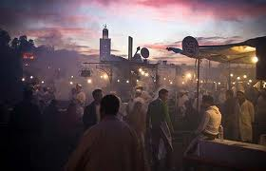
Focus on the Here and Now
who touched me?

Slide 32
Acceptance
The woman at the well
The accused woman
Mary and Lazarus

Slide 33
Willingness

Slide 34
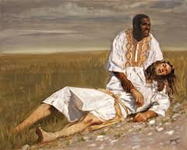
Defusion
The Prodigal Son
The Good Samaritan

Slide 35
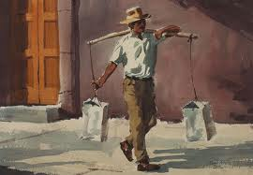
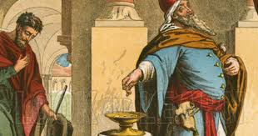
Defusion
True Rest
My burden is easy…..
Specks and Logs
pride vs. humility

Slide 36
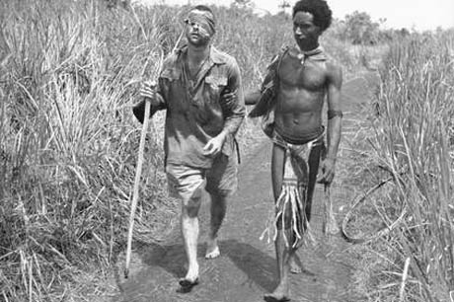
Committed Action
Go the second mile Love the unlovable

Slide 37
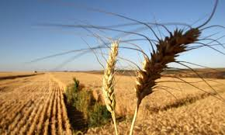
Committed Action
Salt and Light
Parable of the sower

Slide 38
THE PRINCIPLES OF ACT
The Self as Observer
I am/ child like/ life bringer
Acceptance/ Willingness
Woman at the well
Woman accused
Mary and Lazarus
Valued Living
The beatitudes
The extra mile Love your enemies
Defusion /
Watch your thinking
Logs and Specks Greatness in serving
Gain the world lose your life
Committed Action
Salt and Light
The sower and the seed
True Rest
Being Present
Living in the here and now
Who touched me? - Lilies and Birds

Slide 39
References
ACT Stance | Parable | Verses
Self as Observer | I AM | John 8: 48 - 59
 | Who is the greatest? - Children | Luke 9: 46 - 49
 | Rejection vs the Way | Luke 9: 51-56
Present Moment | Do not Worry – The Lilies and the Birds | Luke 12: 22-32
 | The woman who touched Jesus | Luke 8: 43-48
Values | The Beatitudes | Matthew 5: 3-12
 | Salt and Light | Matthew 5: 13-16
 | The Extra mile Love your enemies | Matthew 5: 38- 48
Acceptance | Woman at the Well | John 4: 1- 42
 | Woman Accused | John 8: 2- 12
 | Mary and Lazarus | John 11: 1-27
Willingness | Go the Second Mile | Matthew 5: 38
 | Persistent Widow | Luke 18:1-8
 | Being reviled for the truth | Matthew 11:12
Defusion | Refusal of Oaths | Matthew 5: 33
 | Greatness is serving | Matthew 20:20-28
 | True Rest | Matthew 11: 25-30
 | Gaining the World Losing Life | Luke 9: 23-26
 | Judge not – Specks and Logs | Matthew 7: 1-3
Committed Action | Parable of the Sower | Matthew13 4: 7
 | Salt and Light | Matthew 5: 13-16
 | Greatness is serving | Matthew 20:20-28
 | True Rest | Matthew 11: 25-30

Slide 40
References
Enright, R. D. (1996). Counseling within the forgiveness triad: On forgiving, receiving forgiveness, and self-forgiveness. Counseling and Values, 40(2), 107-126.
Exline, J. J., Root, B. L., Yadavalli, S., Martin, A. M., & Fisher, M. L. (2011). Reparative Behaviors and Self-forgiveness: Effects of a Laboratory-based Exercise. Self and Identity, 10(1), 101-126. doi: 10.1080/15298861003669565
Johnson, E. L., & Myers, D. G. (2010). Psychology & Christianity: five views: IVP Academic.
McMinn, M. R. (2012). Psychology, theology, and spirituality in Christian counseling: Tyndale House Publishers, Inc.
Romero, C., Kalidas, M., Elledge, R., Chang, J., Liscum, K. R., & Friedman, L. C. (2006). Self-forgiveness, spirituality, and psychological adjustment in women with breast cancer. Journal of Behavioral Medicine, 29(1), 29-36.
Tan, S.-Y. (2011). Counseling and psychotherapy: A Christian perspective: Baker Academic.
Worthington, E. L., & Langberg, D. (2012). Religious Considerations and Self-Forgiveness in Treating Complex Trauma and Moral Injury in Present and Former Soldiers. Journal of Psychology & Theology, 40(4).
Worthington Jr, E. (2013). Moving forward: Six steps to forgiving yourself and breaking free from the past: Random House LLC.

